Slide 1

GGP Week 3

Slide 2
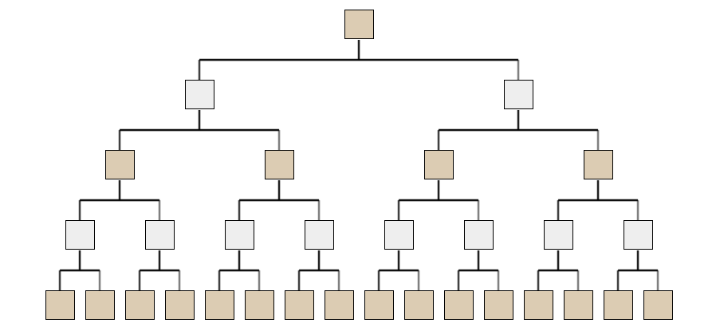
Upcoming week
When do Minimax and AlphaBeta fail?
Notes:
Readings versus video?

Slide 3
Upcoming week
When do Minimax and AlphaBeta fail?
When the game tree is too big to explore.
Notes:
Readings versus video?

Slide 4
Upcoming week
When do Minimax and AlphaBeta fail?
When the game tree is too big to explore.
Notes:
Readings versus video?

Slide 5
Upcoming week
When do Minimax and AlphaBeta fail?
When the game tree is too big to explore.
Notes:
Readings versus video?

Slide 6
Upcoming week
How do we solve this issue?
Idea: Guess how good intermediate states are using heuristics.
Notes:
Readings versus video?

Slide 7
Upcoming week
How do we solve this issue?
Idea: Guess how good intermediate states are using heuristics.
Notes:
Readings versus video?

Slide 8
Upcoming week
How do we solve this issue?
Idea: Guess how good intermediate states are using heuristics.
~70
~30
~10
~20
Notes:
Readings versus video?

Slide 9
Upcoming week
Examples of heuristics
Number of legal moves
Number of opponent’s legal moves
Number of distinct states reachable within n moves
“Similarity” to a desirable terminal state (e.g. look at base propositions)
How “likely” is it that we will win (e.g. simulate random players)
Notes:
Readings versus video?

Slide 10
Upcoming week
Combining heuristics f₁, … , f_{n}
f(s) = w₁ × f₁(s) + ... + w_{n} × f_{n}(s)
public void stateMachineMetaGame(long timeout) { }
Notes:
Readings versus video?

